Slide 1
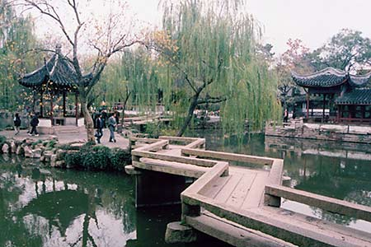
Explicit Pathways to social Change
Student-Centered Learning & Community-Based Learning Approaches
Alma M. Ouanesisouk Trinidad, MSW, PhD
School of Social Work
Portland State University
Professional SW in SW Asia: Education & Qualifications Conference
Phnom Penh, Cambodia
July 21-22, 2015

Slide 2
OVERVIEW
Diversity as a goal and issue to address in higher education with changing demographics
Portland State University’s General Education Program
Sample Student-Centered & Community-Based Learning Processes
Implications on social work education in undergraduate & student learning

Slide 3
University Studies http://www.pdx.edu/unst/university-studies-chart

Slide 4
UNST’s learning outcomes
http://www.pdx.edu/unst/university-studies-goals
Communication
Inquiry & Critical Thinking
Students will learn various modes of inquiry through interdisciplinary curricula—problem-posing, investigating, conceptualizing—in order to become active, self-motivated, and empowered learners.
Students will expand their understanding of the impact and value of individuals and their choices on society, both intellectually and socially, through group projects and collaboration in learning communities.
Students will enhance their capacity to communicate in various ways—writing, graphics, numeracy, & visual and oral means—to collaborate with others in group work, and be competent in appropriate communication technologies
Diversity of Human Experience
Students will enhance their appreciation for and understanding of the rich complexity of the human experience through the study of differences in ethnic and cultural perspectives, class, race, gender, sexual orientation, and ability.
Ethics and Social Responsibility

Slide 5
Student-centered & community-based learning processes
Critical consciousness by centering the learner in deconstructing knowledge production
Understanding race/ethnicity, social justice, and anti-oppression as concepts
Connecting knowledge building and critical praxis in the context of people and places

Slide 6
Process: CRITICAL CONSCIOUSNESS THROUGH DECONSTRUCTING KNOWLEDGE PRODUCTION
INSTRUMENTAL-TECHNICAL
Objective reality beyond subjective perception
Laws that govern human behaviors discovered through empirical research
Human needs can be addressed by learning the laws of human behaviors so predictions can help control life situations
In practice—giving knowledge, skills & methods by expert
INTERPRETIVE PARADIGM
Based on human need to understand self and others
Focus on developing interpretation of meanings of life’s realities
CRITICAL-EMANCIPATORY
Views individuals having different realities and sees opportunities for individuals to reflect on their life experiences as it is essential to social change
Assumes that when individuals develop insights into their way their lives being oppressed by systemic forces, they become empowered from these situations through individual and collective action
Goal is to understanding how the social context affects personal experiences to social action

Slide 7
Process: understanding social location & identities
Activities
Where I’m From Poems
Social Identities Wheel
Creative Piece that demonstrate identities, social locations, etc.
Privilege Walk/Line

Slide 8
ACTIVITY: WHERE I’M FROM
Where I’m From
By Jeremy Posadas
I am from brown skin and mango From rice for breakfast and chicken tocino I am from “hoy ano ba?” and mahal kita I am from my parents who came from overseas I am from tchinilas [slippers] and white trees From the land where people represent their pride
From the party that always has Pac-man’s side I am from red, white, and blue plus gold sun and stars From where I walk instead of taking cars. I am from lumpia and adobo From Lapu-Lapu, you know yo? I am from the bataan death march when our nation cried. From where Tagalog and Spanish coincide. I am from where I ponder what the language means Kumusta na my name’s Jeremy.
I represent the Philippines.

Slide 9
Activity: Social identity wheel

Slide 10
Process: knowledge building & critical praxis with people & place
Approach
Team/Group work
Student led
Scaffolded mentoring
Samples
Youth Summit
Art for Change
Conference for Change
Product for community based partner

Slide 12
Implications
Role of university in creating inquiry courses before declaring majors
Professional development for faculty
Coaching faculty through fellowships
Workload issue for faculty—more engaged teaching which requires more infrastructure
Need to align with tenure expectations
Alignment of learning outcomes in context of local-global context for social change

